Slide 1
AP GoPo Exam
Cheat Sheet
Required Supreme Court Cases

Slide 2
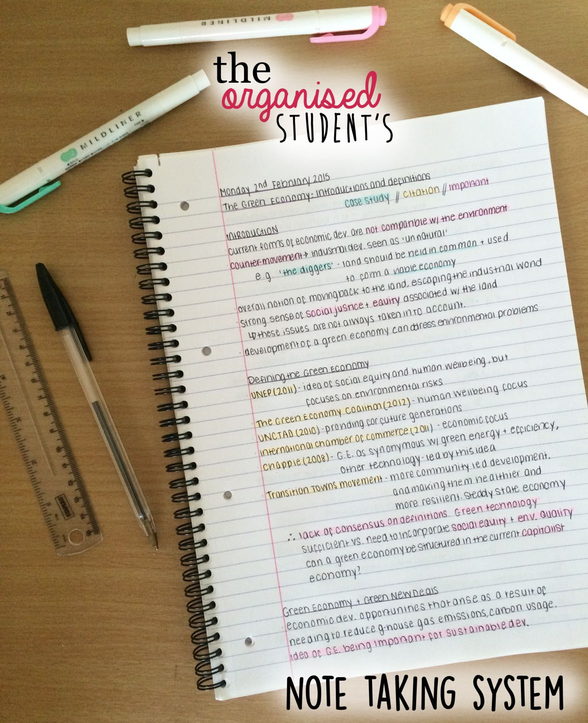
What should you do to review?
Create an organized REVIEW NOTEBOOK just for this OPEN BOOK exam - TIME will be an issue and you can’t waste it looking up info - so have it at your fingertips!
Have clear sections:
Required Docs
Required SCOTUS Cases
Unit 1 - Constitutional Foundations
Unit 2 - Interactions w/ branches of government
Unit 3 - Civil Liberties & Civil Rights

Slide 3
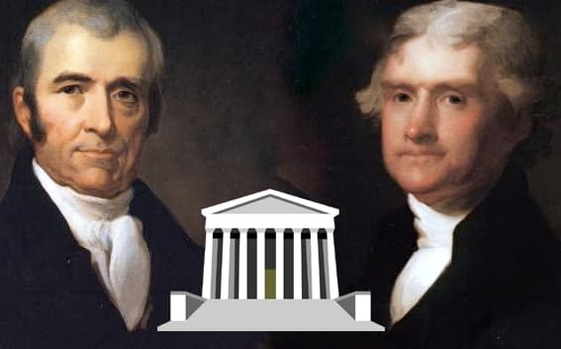
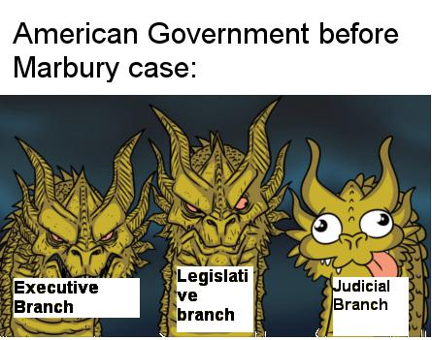
Judicial Branch
Marbury v Madison (1803)
Key Principle: Article III- Judicial Review
Summary: Established the principle of judicial review. Strengthened the power of the Judicial branch by giving the Supreme Court the authority to declare acts of Congress unconstitutional.
Holding: The Supreme Court is allowed to nullify an act of the legislative or executive branch that violates the Constitution

Slide 4
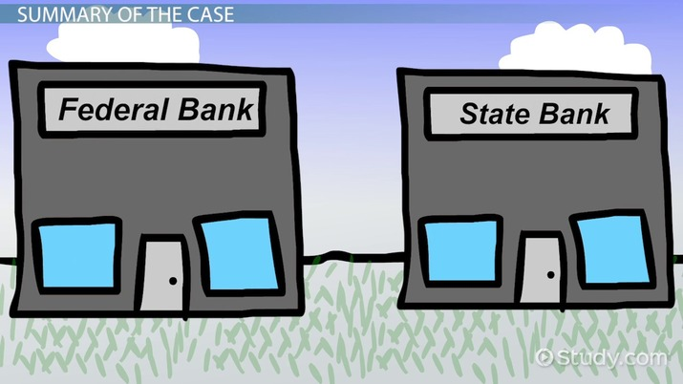
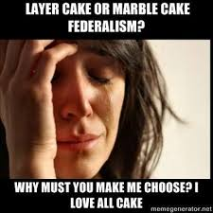
Federalism
McCulloch v Maryland (1819)
Key Principle: Supremacy Clause
Summary: Confirmed the right of Congress to utilize implied powers to carry out its expressed powers. Validated the supremacy of the national government over the states by declaring that states cannot interfere with or tax the legitimate activities of the federal government.
Holding: Established supremacy of the US Constitution and federal laws over state laws

Slide 5
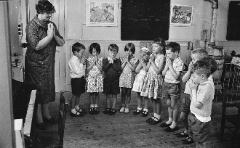
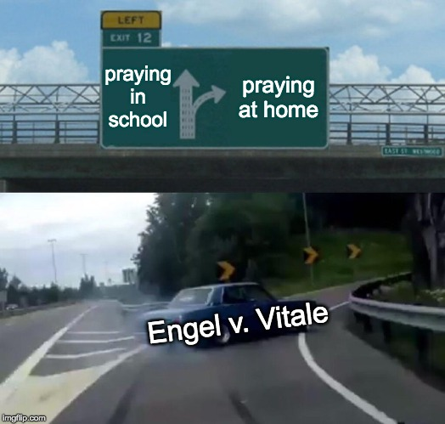
Civil Liberties and Civil Rights
Engle v Vitale (1962)
Key Principle: 1st Amendment - Establishment Clause
Summary: Struck down state-sponsored prayer in public school. Ruled that this was an unconstitutional violation of the Establishment Clause.
Holding: Schools cannot sponsor religious activities. No state sponsored prayer

Slide 6
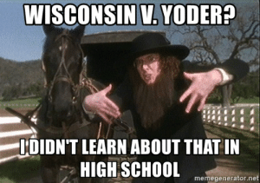
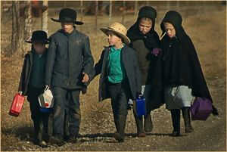
Civil Liberties and Civil Rights
Wisconsin v Yoder (1972)
Key Principle: 1st Amendment -
Free Exercise Clause
Summary: Dealt with the Amish community’s desire to
pull their children from public school before the age of 16
so that they could help with farm and domestic work. The
Court sided with the Amish and held that the parents'
fundamental right to freedom of religion was determined to
outweigh the state's interest in educating its children
Holding: Compelling Amish students to attend school past the eighth grade is illegal.

Slide 7
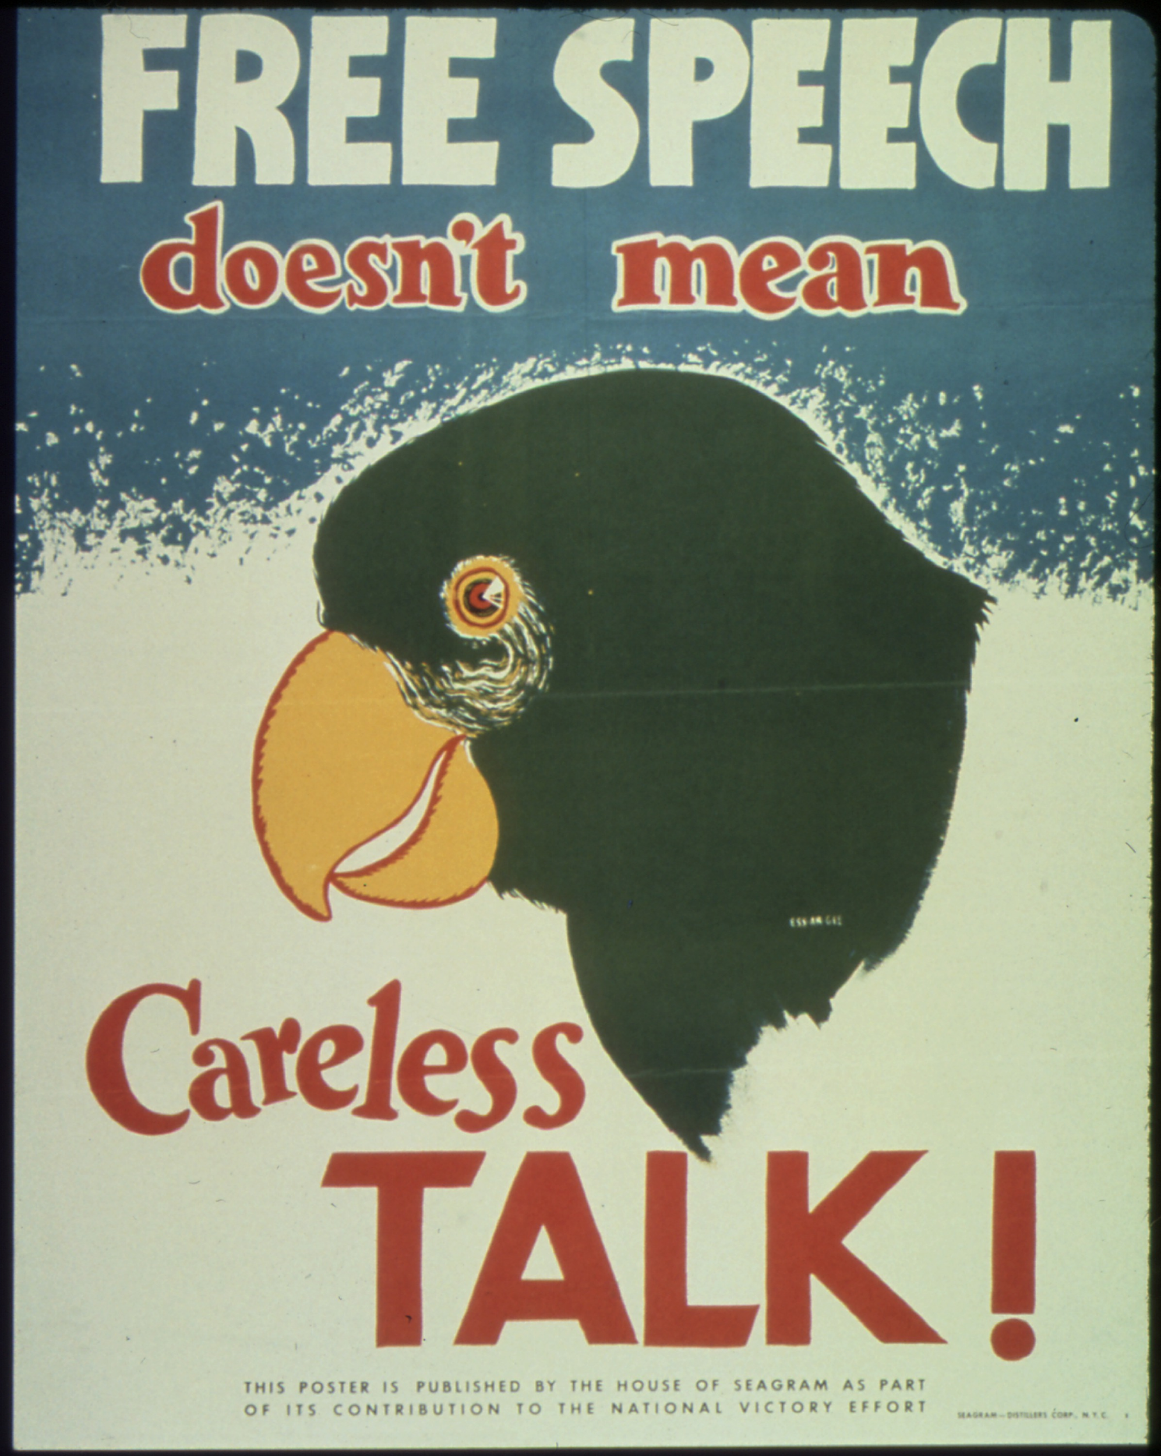
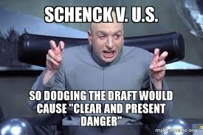
Civil Liberties and Civil Rights
Schenck v United States (1919)
Key Principle: 1st Amendment – Free Speech
Summary: The defendant who handed out anti-draft pamphlets during World War I was not protected under the first Amendment because it created a “clear and present danger.” Established the “clear and present danger” test to define conditions under which public authorities can limit free speech.
Holding: Speech creating a “clear and present danger” is not protected

Slide 8
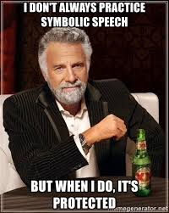
Civil Liberties and Civil Rights
Tinker v Des Moines (1969)
Key Principle: 1st Amendment- Freedom of Speech
(Symbolic Speech)
Summary: Protected some forms of symbolic speech.
Ruled that students do not “shed their constitutional rights”
to freedom of speech or expression at the schoolhouse gate.
Schools forbidding the wearing of armbands is a violation
of symbolic speech
Holding: Public school students have the right to wear black
armbands in school to protest the Vietnam War because it does not cause a disruption

Slide 9
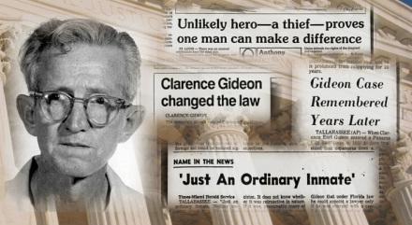
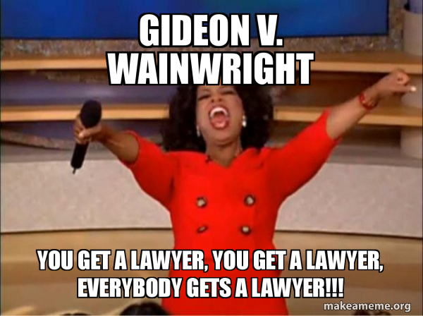
Selective Incorporation
Gideon v Wainwright (1963)
Key Principle: 6th Amendment - Right to Counsel
Summary: Ruled that the Sixth Amendment right-to-counsel provision applies to those accused of major crimes under state laws. Illustrated the process of incorporation by which the Sixth Amendment was applied to the states through the Due Process Clause of the Fourteenth Amendment.
Holding: Guarantee of an attorney for the poor or indigent

Slide 10
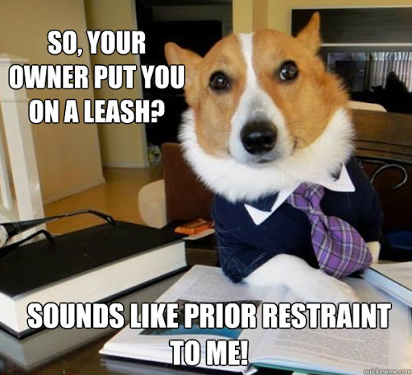
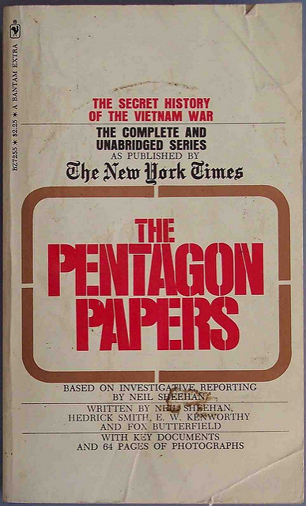
Civil Liberties and Civil Rights
New York Times v U.S. (1971)
Key Principle: 1st Amendment – Freedom of Press
Summary: Government can almost never use prior restraint. Protections for the press were established here. The ruling made it possible for newspapers to publish the then-classified Pentagon Papers without risk of government censorship or punishment. Court held that executive efforts to prevent the publication violated the 1st Amendment
Holding: Establishes a “heavy presumption against prior restraint” even in cases involving national security.

Slide 11
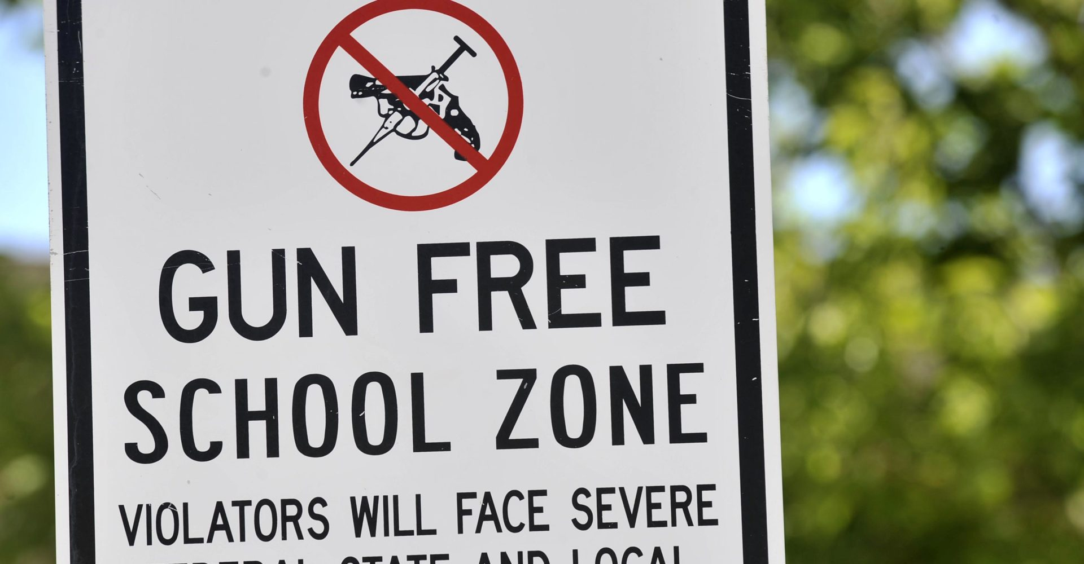
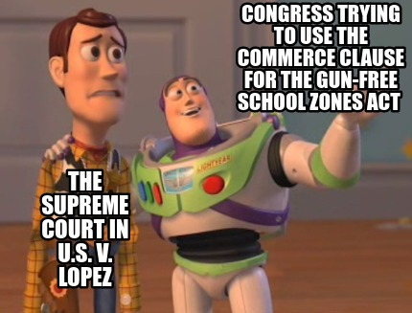
Federalism
United States v Lopez (1995)
Key Principle: Commerce Clause
Summary: Gun Free School Zones Act exceeded Congress' authority to regulate interstate commerce.The Court ruled that Congress did not have the authority under the Commerce Clause to outlaw guns near schools.
Holding: Congress may not use the commerce clause to make possession of a gun in a school zone a federal crime

Slide 12
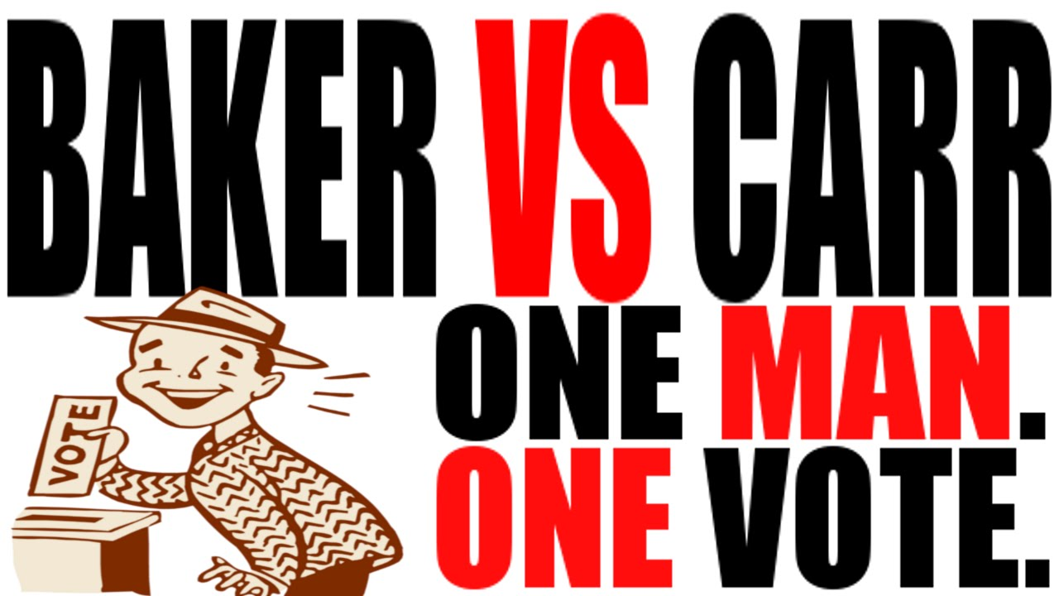
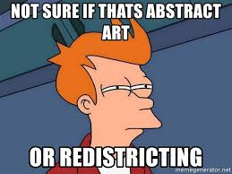
Legislative Branch/ Gerrymandering
Baker v Carr (1962)
Key Principle: 14th Amendment - Equal Protection Clause
Summary: Decided that redistricting (attempts to change the way voting districts are delineated) issues present justiciable questions, thus enabling federal courts to intervene in and to decide redistricting cases. Ordered state legislative districts to be as equal as possible.
Holding: Established “one man, one vote” and opens door to courts to reviewing redistricting challenges

Slide 13
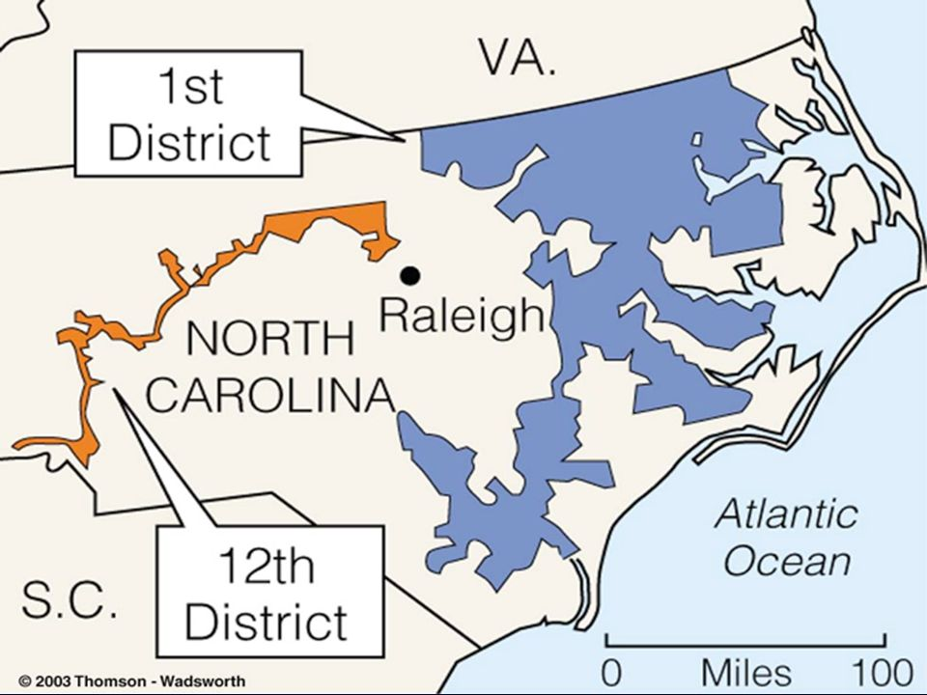
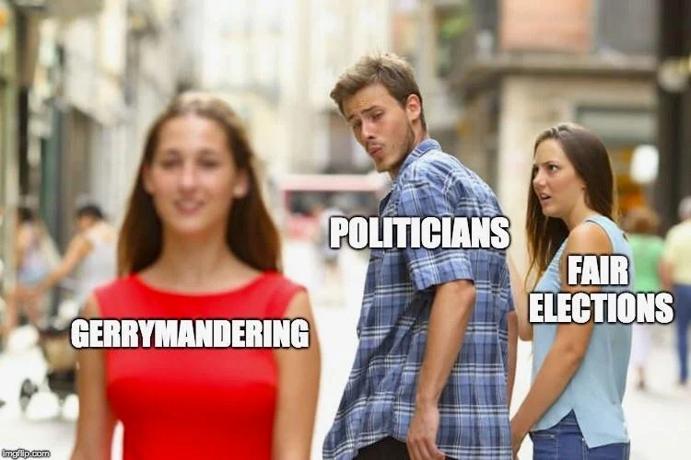
Legislative Branch/ Gerrymandering
Shaw v Reno (1993)
Key Principle: 14th Amendment - Equal Protection Clause
Summary: A case involving gerrymandering, redistricting based on race must be held to a standard of strict scrutiny under the equal protection clause -
No racial gerrymandering. Race cannot be the sole or predominant factor in redrawing legislative boundaries. Majority-Minority districts.
Holding: Legislative redistricting must be conscious of race

Slide 14
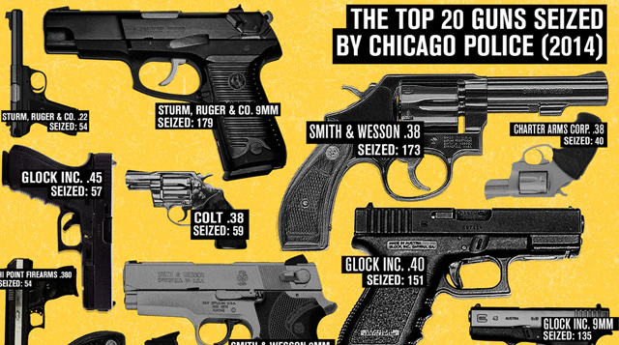
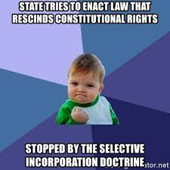
Selective Incorporation
McDonald v Chicago (2010)
Key Principle: 14th Amendment due process clause,
Privileges and Immunities Clause, 2nd amendment
Summary: The Court held that the right of an individual
to “keep and bear arms” protected by the 2nd Amendment
is incorporated by the Due Process Clause of the 14th
Amendment and applies to the states. The decision cleared
up the uncertainty left in the wake of District of Columbia
v. Heller as to the scope of gun rights in the states.
Holding: Right to keep and bear arms for self-defense applies to the states

Slide 15
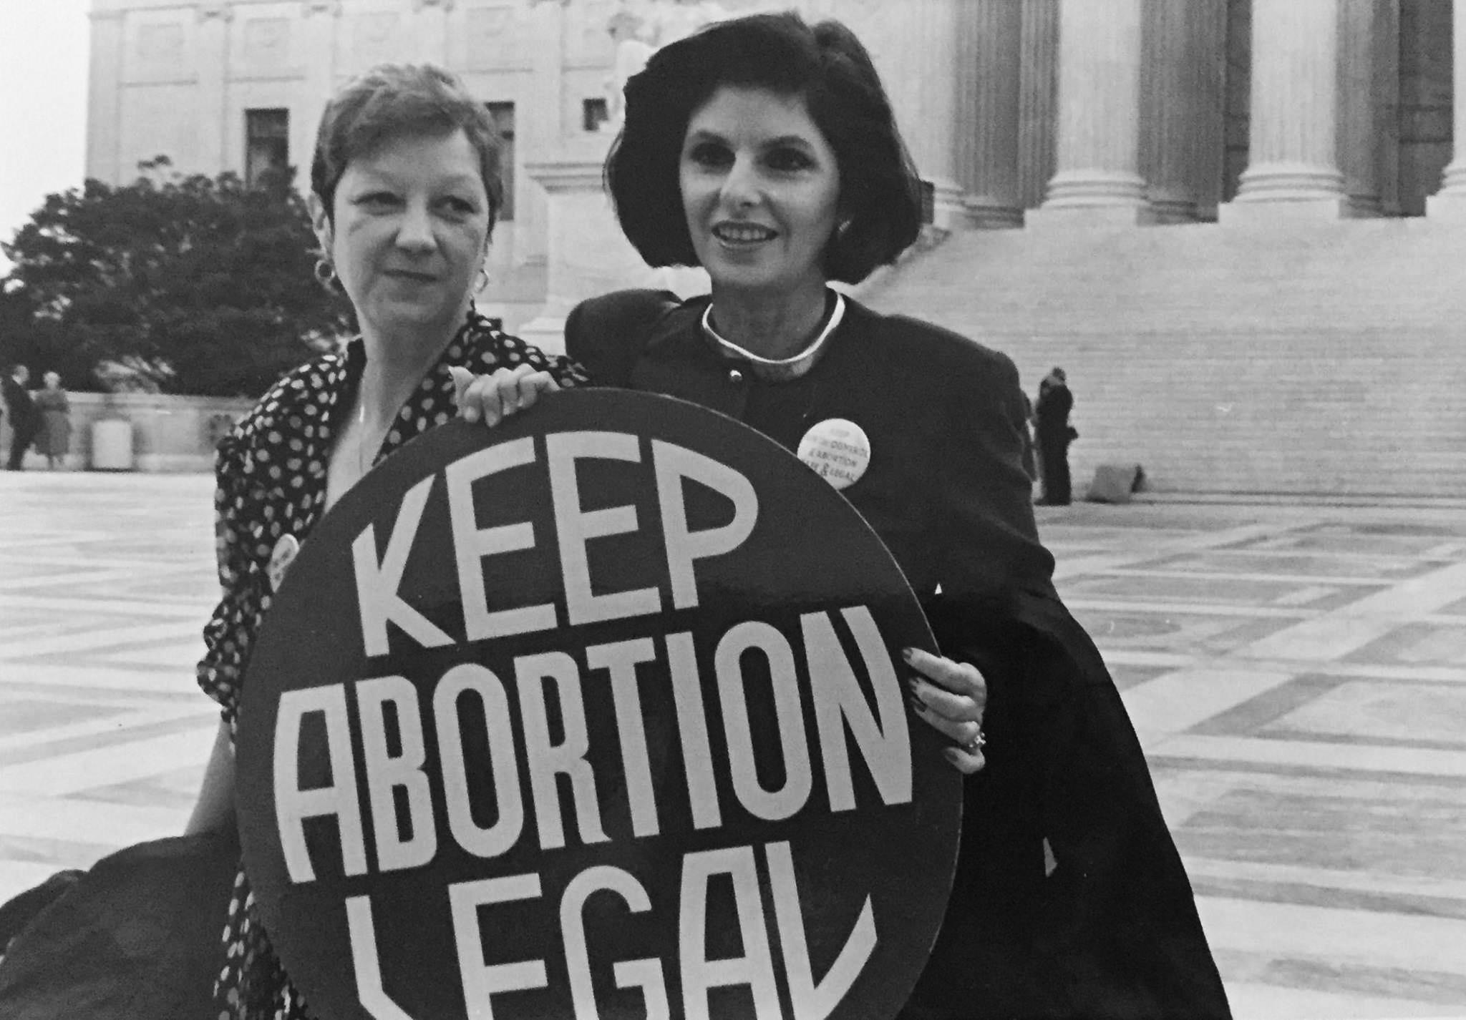
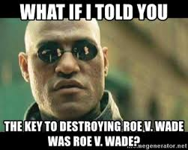
Selective Incorporation
Roe v Wade (1973)
Key Principle: 14th Amendment Due Process Clause, and 9th Amendment implied right of privacy (establish through Griswold v. CT), 4th Amendment
Summary: Ruled that the decision to obtain an abortion is protected by the right to privacy implied by the Bill of Rights.
Holding: Protects the right of a woman to have an abortion

Slide 16
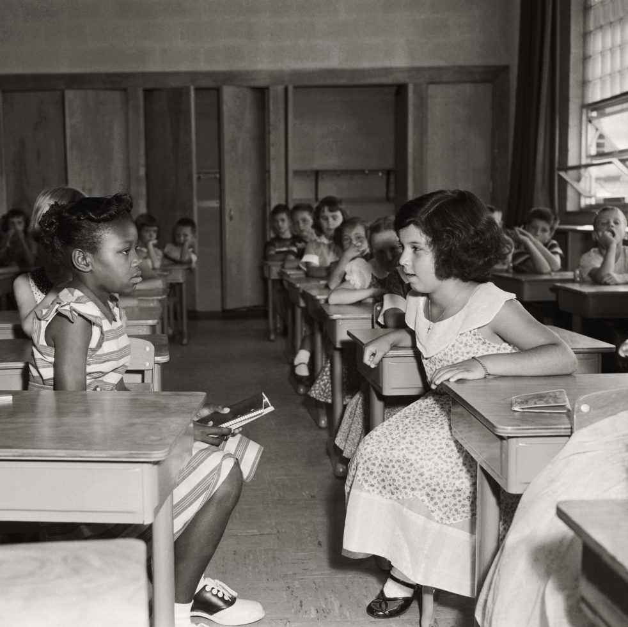
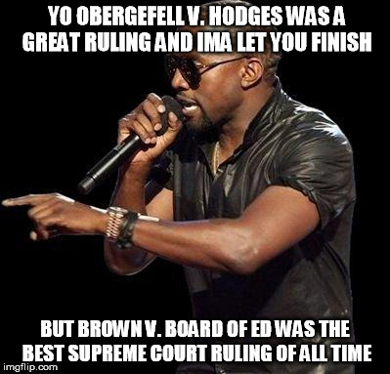
Equal Protection
Brown v Board of Ed. (1954)
Key Principle: 14th Amendment - Equal Protection Clause
Summary: Ruled that racially segregated schools violated the Equal Protection Clause of the Fourteenth Amendment: Reversed the principle of “separate but equal” established in Plessy v. Ferguson. Desegregated schools.
Holding: Raced based segregation is illegal.

Slide 17
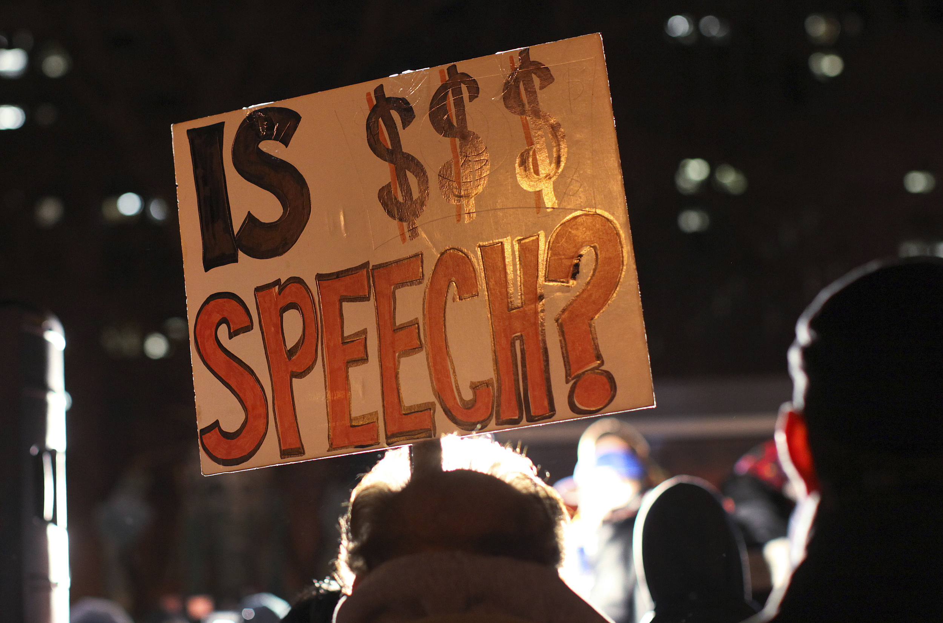
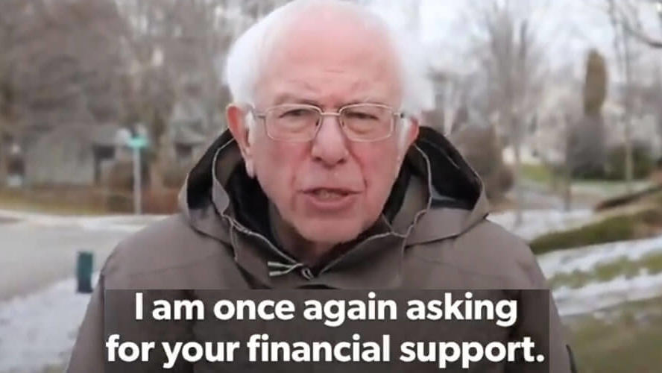
Campaigns
Citizens United v F.E.C. (2010)
Key Principle: 1st Amendment - Free Speech
Summary: Struck down the restrictions on independent
expenditures as a violation of the 1st Amendment.
Overturned the 2002 Bipartisan Campaign Reform Act (McCain-Feingold), which banned soft money. Led to
record spending in the 2010 election cycle by
corporations and special interests.
Holding: Political spending by corporations, associations, and labor unions is protected and cannot be limited by law; Money = Speech

