Slide 1
AP GoPo Exam
Cheat Sheet
Unit 3 Review - Judicial Branch, Civil Rights & Civil Liberties

Slide 2
What should you do to review?
Create an organized REVIEW NOTEBOOK just for this OPEN BOOK exam - TIME will be an issue and you can’t waste it looking up info - so have it at your fingertips!
Have clear sections:
Required Docs
Required SCOTUS Cases
Unit 1 - Constitutional Foundations
Unit 2 - Interactions w/ branches of government
Unit 3 - Judicial Branch, Civil Liberties & Civil Rights

Slide 3
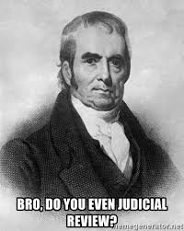
Unit 3 Overview - Judicial Branch
The federal judiciary, including the Supreme Court, established under Article III, is designed to be an independent branch of government. The Court’s most far-reaching power, judicial review, was justified in Marbury v. Madison (1803), where the Court declared that it had the constitutional authority to overturn acts of Congress, state laws, or executive action deemed to be unconstitutional. Thus, judicial review serves as an important check on other branches of government. Appointed for life, justices are somewhat insulated from public opinion. It is not surprising that over the years the Court has handed down decisions that have been unpopular and controversial. Congress and the president may influence the Court through the appointment process, by refusing to implement a Court decision, or by passing legislation that changes the Court’s jurisdiction.

Slide 4
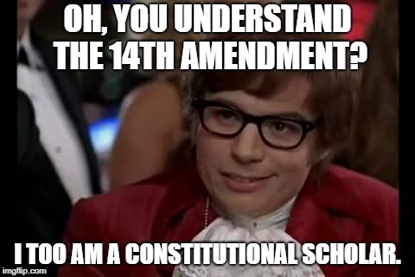
Unit 3 Overview - Civil Liberties & Civil Rights
The Constitution, but especially the Bill of Rights and the Fourteenth Amendment, are used to assert the rights of citizens and protect groups from discrimination. As such, the government must respect the dignity of the person and assure equal treatment, with its power constrained in the process of protecting individual freedoms. The Fourteenth Amendment includes two clauses that affirm and protect civil rights and liberties—the due process clause and the equal protection clause. The courts must balance the desire for social order with the protection of individual rights and freedoms when considering due process and equal protection challenges.
In a process known as selective incorporation, the Supreme Court has used the power of judicial review to interpret the due process clause in such a way as to prevent states from unduly restricting fundamental freedoms. The Court has been called upon to interpret protections for freedom of political expression and religious exercise, the right to bear arms, the right of privacy, and the rights necessary to ensure that those accused of crimes receive a fair trial.

Slide 5
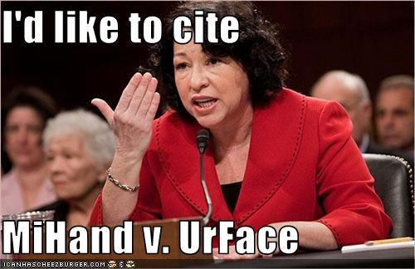
Unit 3 Essential Questions
How do the branches of the national government compete and cooperate in order to govern?
To what extent have changes in the powers of each branch affected how responsive and accountable the national government is in the 21st century?
To what extent do the U.S. Constitution and its amendments protect against undue government infringement on essential liberties and from invidious discrimination?
How have U.S. Supreme Court rulings defined civil liberties and civil rights?

Slide 6
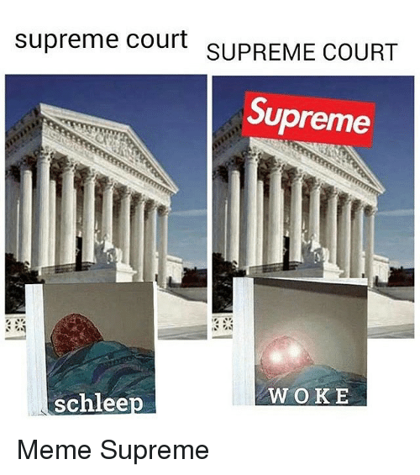
Big Idea #1:
The design of the judicial branch protects the Supreme Court’s independence as a branch of government, and the emergence and use of judicial review remains a powerful judicial practice.
 | Describe the Main Ideas | Explain the Importance of the Main Ideas
Article III of the Constitution | Lays out the structure, functions, and powers of the judicial branch of the United States | Establishes a Supreme Court and a three branch separation of powers
Judicial Review | The ability of courts to review legislation and government actions to determine if their intent is supported by the Constitution | Allows for an important check on the Congress and the Presidency
Federalist No. 78 | Written by Alexander Hamilton, it outlines how the judicial branch will operate and why it is important that it be structured as laid out in the Constitution | As part of the Federalist Papers it is an important document showing the framers intent for the judicial branch and why it was important to ratify the Constitution

Slide 7
Judicial decision making:
Importance of precedents and stare decisis
 | Precedents | stare decisis | Landmark Case
Define | An earlier event of action that is regarded as an example or guide to be considered in subsequent similar circumstances | The legal principle determining points in litigation according to precedent | A court case (usually Supreme Court case) that serves as an important benchmark for historical purposes and legal precedent
Explain | Stability of law is an important part of American politics...constantly changing laws would lead to inconsistency and would undermine legal institutions | Legalization of abortion is a legal principle that has been in place since the Supreme Court’s decision in Roe v. Wade | The Supreme Court issues maybe 75-100 decisions per year, however some decisions end up being more important than others for historical reasons and for establishing legal precedent
Provide an example | Plessy v. Ferguson was a precedent that was overturned in Brown v. Board of Education | Roe v. Wade | Marbury v. Madison

Slide 8
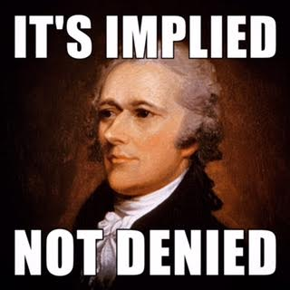
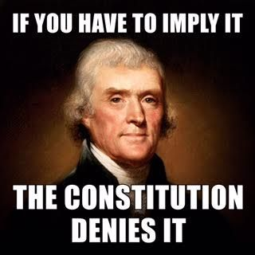
Ideology and SCOTUS
Loose Constructionist | Strict Constructionist
One favoring a liberal construction of the Constitution of the U.S. to give broader powers to the federal government...broad government actions on things like health care which is not mentioned in the Constitution would be an example Loose constructionism looks to what someone thinks was the "intent" of the framers' language and expands and interprets the language extensively to meet current standards of human society today. | Interpreting the Constitution based on a literal and narrow definition of the text without reference to the differences in conditions when the Constitution was written and modern conditions, inventions and societal changes

Slide 9
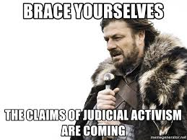
Politics and the Supreme Court’s Power
Judicial Activism | Judicial Restraint
The view that Supreme Court justices (and even other lower-ranking judges) can and should interpret the texts of the Constitution and laws in order to serve the judges' own estimates of the needs of society when the elected branches of the Federal government and/or the various state governments seem to them to be failing to meet those needs. | The view that the Supreme Court (and other courts) should not read their own philosophies or policy preferences into the Constitution and laws and should whenever reasonably possible interpret the law so as to avoid second guessing the policy decisions made by other governmental institutions such as Congress, the President and state governments within their constitutional spheres of authority. Judges should defer to the decisions of the elected "political" branches of the Federal government and of the states in matters of policy making.

Slide 10
Checks and Balances: How other branches can limit the Supreme Court’s power.
Restrictions on Supreme Court | Description | Example
Constitutional Amendments | Changes made to the Constitution over time | The Supreme Court cannot interpret a law in a manner that would take away freedom of speech
Judicial appointments and confirmations | The ability of the Senate through its “advice and consent” power to approve federal judges | Brett Kavanaugh nomination process from October 2018
President evading/ignoring SCOTUS decisions | Presidents can choose how much or little to enforce SCOTUS decisions through their directives to the executive branch | Andrew Jackson attributed quote even though he might not have really said it... “Justice Marshall has made his decision, now let him enforce it.” Marshall had declared state criminal jurisdiction over Indian territories void
States evading/ignoring SCOTUS decisions | States will go to great lengths at times to prevent SCOTUS protected rights from being implemented | Various state bills regarding abortion...fetal heartbeat bill, abortion doctors needing hospital admitting rights etc.
Congressional Acts | Laws passed by Congress that can modify Supreme Court decisions | At any time Congress can pass a law that changes or limits the Supreme Court’s jurisdiction over cases. No modern examples as the respect for the institution of the Supreme Court would make this seem as an obvious power play by Congress

Slide 11
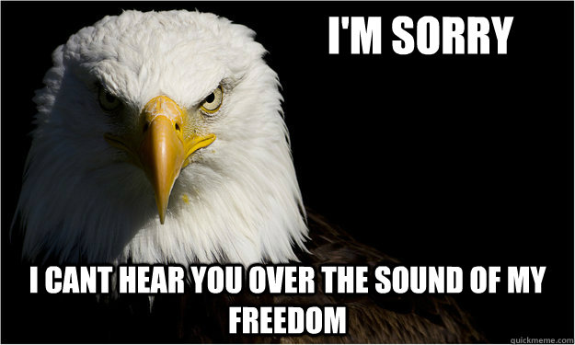
Big Idea #2:
Provisions of the U.S. Constitution’s Bill of Rights are continually being interpreted to balance the power of government and the civil liberties of individuals.
Civil Liberties | Civil Rights
Individual freedoms given to citizens as protection against government interference | Protections from unequal treatment by government for possessing certain characteristics such as race, gender, disability, sexual orientation etc.
Special Note:
The U.S. Constitution includes a Bill of Rights specifically designed to protect individual liberties and rights.
Civil rights are guaranteed to all citizens under the due process and equal protection clauses of the U.S. Constitution, as well as acts of Congress.
The application of the Bill of Rights is continuously interpreted by the courts.

Slide 12
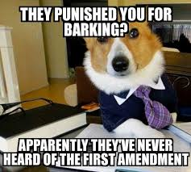
First Amendment
Establishment Clause | Free Exercise Clause
Prohibits government from making any law that establishes religion. What constitutes establishment has been settled on a case by case basis by the Supreme Court over the years. | Prohibits government from making any law that restricts a person from freely practicing their religion. What constitutes free exercise has been settled on a case by case basis by the Supreme Court over the years.
Special Note:
The interpretation and application of the First Amendment’s establishment and free exercise clauses reflect an ongoing debate over balancing majoritarian religions practice and free exercise.
The Supreme Court has on occasion ruled in favor of states’ power to restrict individual liberty; for example, when speech can be shown to increase the danger to public safety.
Religion and SCOTUS | Speech and Press and SCOTUS
Engel v. Vitale | Tinker v. Des Moines
Wisconsin v. Yoder | Schenck v. U.S.
 | New York Times Co. v. U.S.

Slide 13
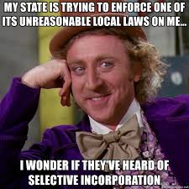
Big Idea #3:
Protections of the Bill of Rights have been selectively incorporated by way of the Fourteenth Amendment’s due process clause to prevent state infringement of basic liberties.
Selective Incorporation | The part by part application of the Bill of Rights to state and local government through court decisions
Due Process | The requirement that citizens accused of crimes are given fair treatment throughout the entire criminal process from arrest through trial and potentially appeal
Equal Protection | Clause in the 14th Amendment that guarantees all citizens are to receive equal protection under the law. Has been interpreted broadly to include many protections that aren’t otherwise specifically spelled out in the Constitution.
Selective Incorporation | Constitutional principles
McDonald v Chicago | -2nd Amendment -Selective Incorporation -14th Amendment (Due Process Clause)

Slide 14
Big Idea #4:
The Fourteenth Amendment’s equal protection clause as well as other constitutional provisions have often been used to support the advancement of equality.
 | Causes of Social Movement | Outcomes of the Social Movement | Constitutional principles
King’s “Letter from a Birmingham Jail” | Historical discrimination against African Americans in the United States | One of the most influential documents on civil rights to this day...required foundational document for the course | Equality under the law, justice, due process
National Organization of Women (NOW) | Historical discrimination against women in the United States | Increased representation of women in legislative, executive, and judicial positions | Equality under the law, no discrimination under the law
Pro-Life Movement | Concerns after the decision in Roe v. Wade legalizing abortion | More state-led restrictions on abortion | Federalism
LGBTQ rights | Legal discriminations against LGBTQ individuals | Increased protections via legislation and court decisions | Equality under the law, no discrimination under the law

Slide 15
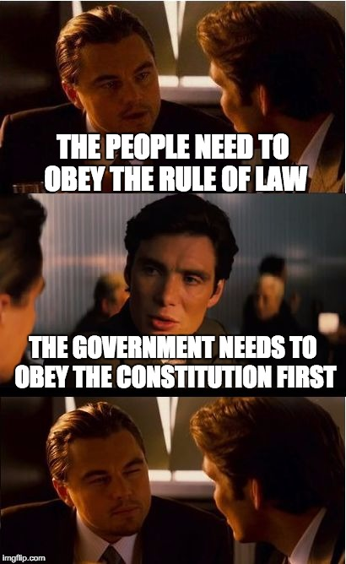
Big Idea #5:
Public policy promoting civil rights is influenced by citizen–state interactions and constitutional interpretation over time.
Civil Rights Act of 1964 | Civil rights law that bans discrimination based on race, color, creed, religion, sex, or national origin | -14th Amendment
Title IX of the Education Amendments Act of 1972 | Protects against discrimination due to sex in any athletic program or activity that receives federal financial assistance | -14th Amendment -19th Amendment
The Voting Rights Act of 1965 | Abolished many legal barriers that were being used to prevent African-American voting at the time of passage | -14th Amendment -15th Amendment -24th Amendment

Slide 16
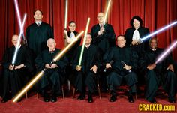
Big Idea #6:
The Supreme Court’s interpretation of the U.S. Constitution is influenced by the composition of the Court and citizen–state interactions. At times, it has restricted minority rights and, at others, protected them.
Congressional Acts | Causes of Affirmative Action Acts | Outcome of Affirmative Action Acts | Constitutional principles
Affirmative Action Acts | Inequality in hiring and awarding of federal contracts for minorities and women. | Increased employment and awarding of federal contracts for minorities and women. Increased admittance to colleges and universities for minorities and women. | -Equal Protection Clause of the 14th Amendment
Special Note: The debate on affirmative action includes justices who insist that the Constitution is colorblind and those who maintain that it forbids only racial classifications designed to harm minorities, not help them.
Decisions demonstrating that minority rights have been restricted at times and protected at other times include:
The Supreme Court upholding the rights of the majority in cases that limit and prohibit majority-minority districting

