Slide 1
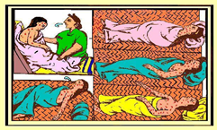
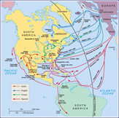
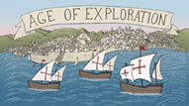
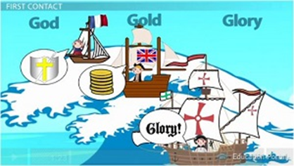
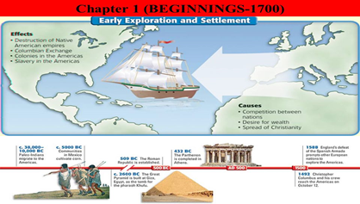
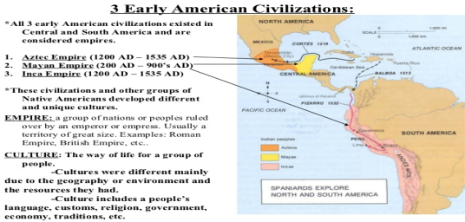
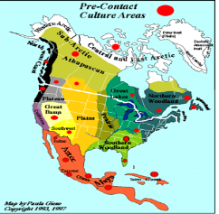
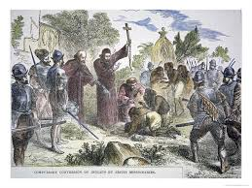
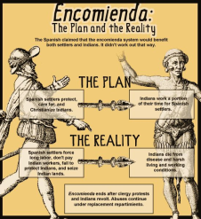
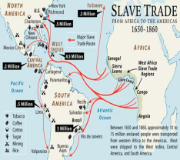
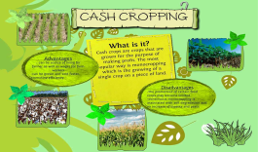
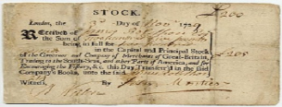
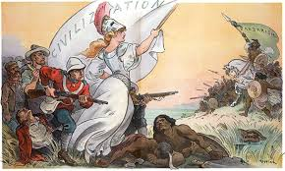
Exploration & Colonization
Migration & Settlement
Smallpox
America in the World
European Competition
Geography & the Environment
Agricultural Civs—Aztec, Anasazi
Mobile Hunters—Plains Indians
Mixed—Iroquois, Algonquian
P
Politics & Power
Conquest & Resistance
Native American Conversion
I
American & National Identity
Mestizo
Zambo
E
Cash “Crops”—Silver, sugar
Work, Exchange & Technology
Joint-Stock Corporation
S
Culture & Society
Protestant Reformation
“Civilized” vs. “Subjugated”

Slide 2
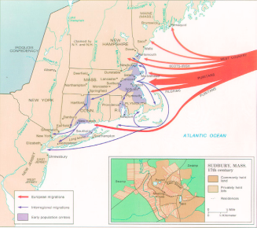
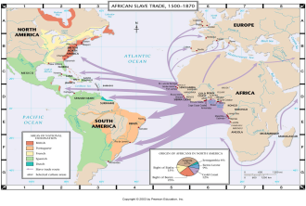
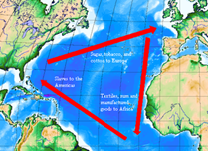
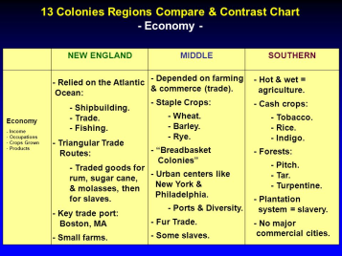
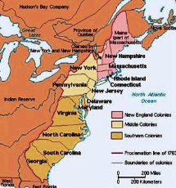
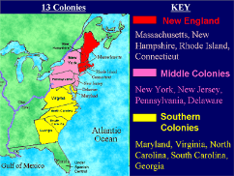
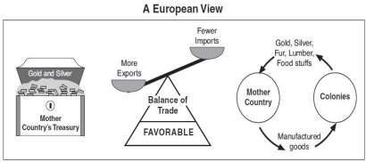
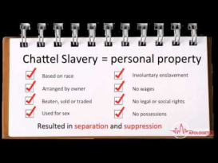
PERIOD TWO—1607-1754
Germans &
Scots-Irish
Slaves
Migration & Settlement
Puritans
America in the World
European Competition
Triangular Trade
Geography & the Environment
New England—Commerce
Middle—Breadbasket
Southern—Tobacco, Rice
13 Colonies
P
Politics & Power
Colonists vs
Native Americans
Beaver Wars
King Philips War
I
American & National Identity
Emerging American Identity
New England
Middle &
Southern Colonies
E
Indentured
Servitude
Work, Exchange & Technology
Chattel Slavery
Mercantilism
S
Culture & Society
Enlightenment
Great Awakening

Slide 3
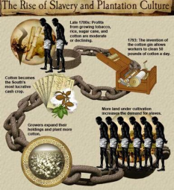
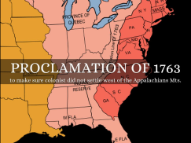
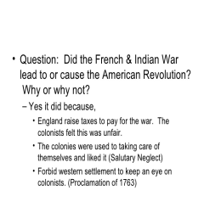
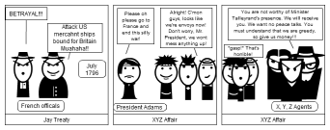
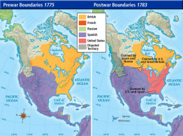
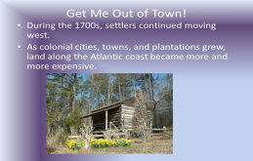
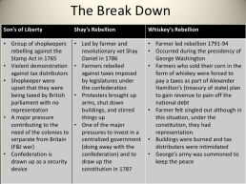
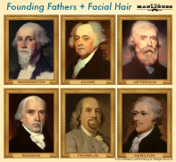
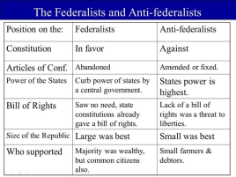
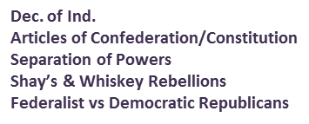
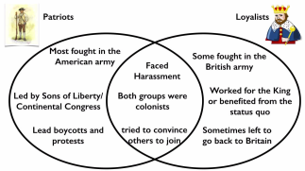
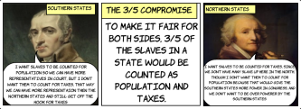
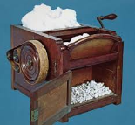
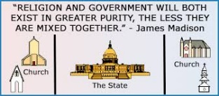
PERIOD 3—1754-1800
Proclamation Line of 1763
Northwest Ordinance
Spread of Slavery
Migration & Settlement
Treaty of Paris & the X,Y,Z Affair
America in the World
French & Indian War
American Revolution
French Revolution
Geography & the Environment
The New U.S.A.
Expansion
P
Politics & Power
Pontiac's Rebellion
Paine’s Common Sense
American Rev.
Franklin, Washington, Adams
Jefferson, Madison, Hamilton
Continental Congresses
I
3/5 Compromise
American & National Identity
Loyalists vs Patriots
Cotton Gin
Industrial Rev.
E
Work, Exchange & Technology
Stamp Act
Sugar Act
Coercive (Intolerable) Acts
S
Republicanism &
Republican Motherhood
Culture & Society
Separation of Church & State

Slide 4
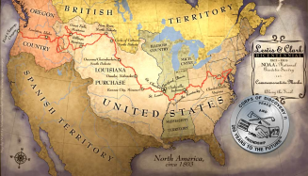
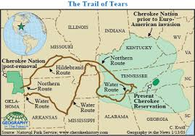
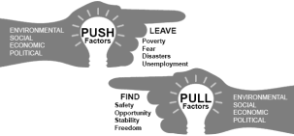
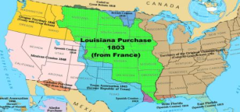
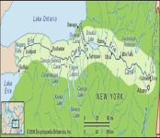
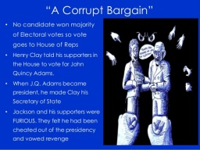
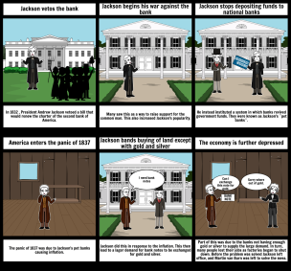
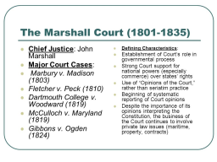
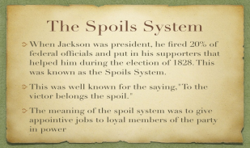
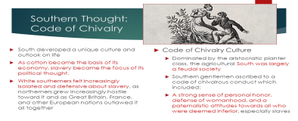
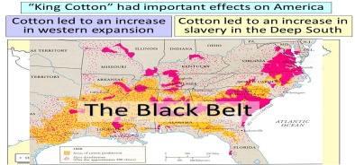
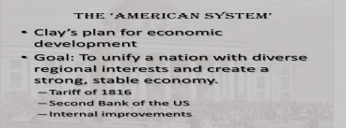
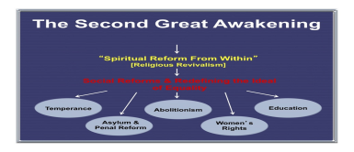
PERIOD 4—1800-1848
Westward Bound
Indian Removal
Irish-German immigration
Migration & Settlement
Monroe Doctrine
America in the World
Geography & the Environment
Louisiana Purchase
Erie Canal
Commercial
Agriculture
P
Bank War
Spoils System
Whigs
Politics & Power
Era of Good Feelings
Corrupt Bargain
Marshall Court Rulings
Missouri Compromise
I
Code of Chivalry
American & National Identity
Nationalism
Nativism
E
Work, Exchange & Technology
American System
Growth of Industry /Transportation
King Cotton
S
Transcendentalism
Cult of Domesticity
Culture & Society
Reformers

Slide 5
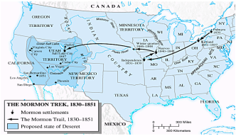
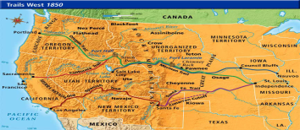
Mormons
Overland Routes
Underground R & R
PERIOD 5—1848-1877
Migration & Settlement
“Fifty-Four Forty or Fight!”
Mexican-American War
America in the World
Geography & the Environment
Homestead Act
CA Gold Rush
Expansion of King Cotton
P
Politics & Power
Compromises of 1850 & 1877
Popular Sovereignty
Civil War/Mexican-American War
13th, 14th & 15th amendments
Reconstruction
Nativism/Know Nothings
Radical Republicans vs Redeemers
I
American & National Identity
Railroads
Industrial Technology
Sharecropping/Tenant Farming
E
Work, Exchange & Technology
Manifest Destiny
Uncle Tom’s Cabin/Abolition
S
Culture & Society

Slide 6
Turner’s Frontier Thesis
The Dawes Act
The Ghost Dance
PERIOD 6—1865-1898
Migration & Settlement
Chinese Exclusion Act
Olympics
Ellis Island
America in the World
Geography & the Environment
Transcontinental R & R
New South
Mining & Cattle Frontiers
P
Politics & Power
Indian Wars
Key Strikes!
I
Old v. New Immigrants
Urbanization/Ethnic Neighborhoods
American & National Identity
E
Boss & Political Machines
Robber Barons & Laissez-Faire Capitalism
Work, Exchange & Technology
Technology/Innovations
S
Social Darwinism/Social Gospel
Jim Crow
Popular Culture
Culture & Society

Slide 7
Braceros
Immigration Acts/Quotas
PERIOD 7—1890-1945
Great Migration
Migration & Settlement
Spanish-American War
WWI/WWII
Diplomacy
America in the World
Geography & the Environment
Sierra Club-National Parks
Panama Canal
Dust Bowl
P
Politics & Power
T Roosevelt/FDR
WWI/WWII
Great Depression
Progressive Party
16th-22nd Amendments
I
Flappers & Suffragettes
Birth of a Nation/Lynchings
American & National Identity
E
Trust Busting
Consumerism
Great Depression
Work, Exchange & Technology
S
Harlem Renaissance
Freud/Sexual “revolution”
Modernism v. Fundamentalism
Culture & Society

Slide 8
Suburbs & Sunbelt
Interstate Highway
Immigration Shifts
PERIOD 8—1945-1980
Migration & Settlement
Cold War
Israel/Middle East
Truman Doctrine/Marshall Plan
America in the World
Geography & the Environment
Sunbelt v Rustbelt
Cold War
1st, 2nd & 3rd Worlds
P
Politics & Power
Fair Deal
Great Society
Watergate
Silent Majority
Truman, Ike, JFK, LBJ, Nixon, Ford & Carter
I
Black Power
Counter Culture
Feminism
AIM/UFW
American & National Identity
E
New Technology
Stagflation
Right to Work
Work, Exchange & Technology
S
Civil Rights Movement
Red Scare #2
Pop Culture
Culture & Society

