Slide 1
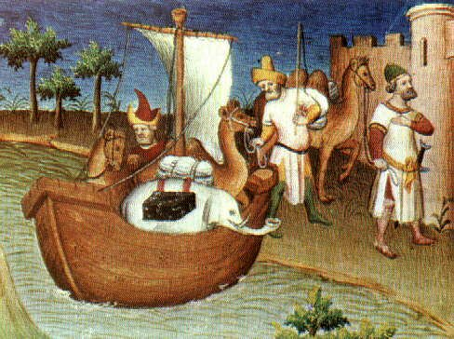
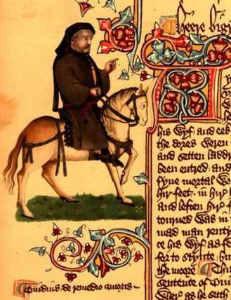
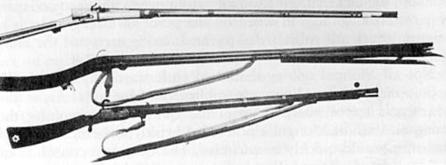
Marco
Polo
travels
to China.
1271
Dante
finishes
The
Divine
Comedy.
1321
Cosimo
de’ Medici
rules
Florence.
1389-
1464
Warfare
changes;
guns and
gunpowder
introduced
into battle.
1320
Geoffrey
Chaucer
writes The
Canterbury
Tales.
1380s

Slide 2
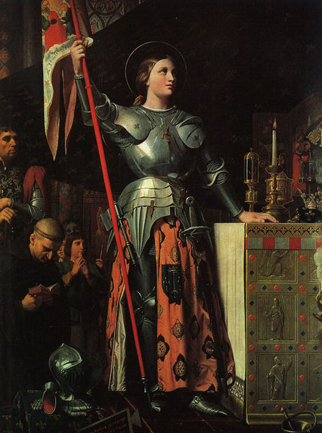
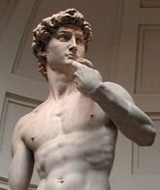
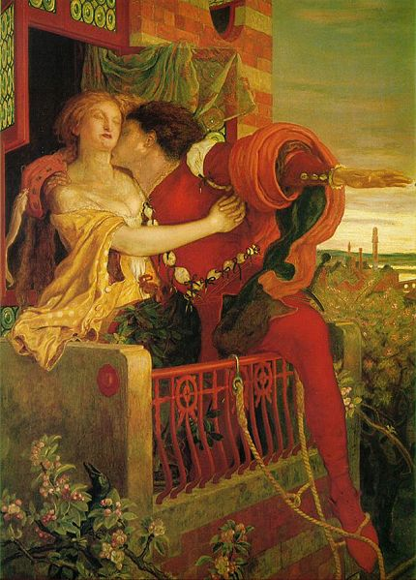
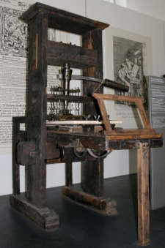
Joan
of Arc
leads France
to victory
against
England.
1429-1430
Michelangelo
sculpts
David.
1504
Leonardo
da Vinci
paints the
Mona Lisa.
1505-
1507
Shakespeare
writes
Romeo
And Juliet.
1595-1596
Gutenberg
develops
movable
type and
mechanical
printing.
1439

Slide 3
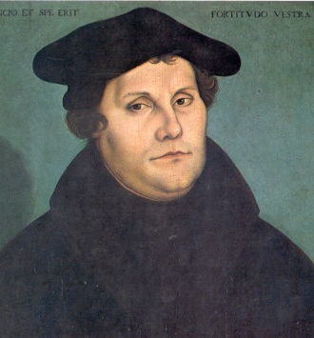
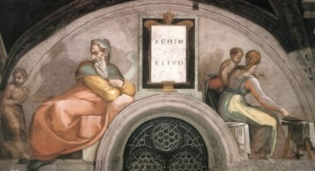
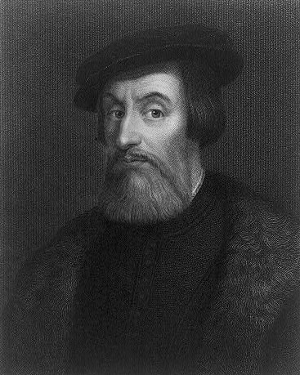
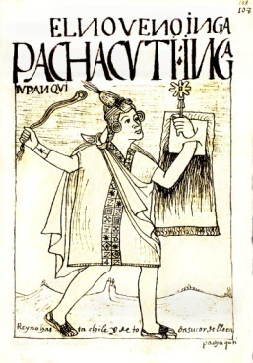
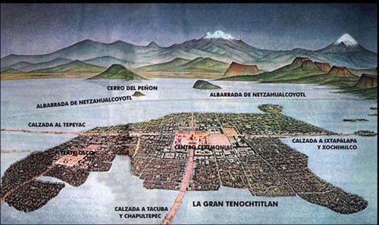
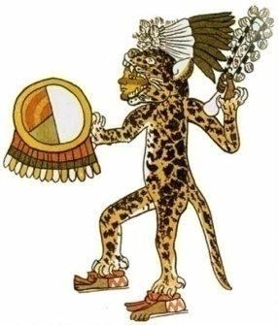
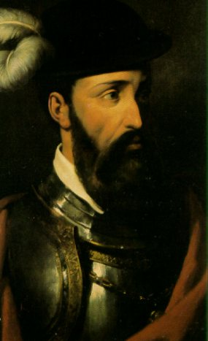
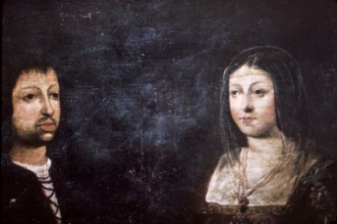
1271
1321
1455
1508-1512
1517
1594-1595
Dante
finishes
The Divine
Comedy.
Gutenberg
develops
the printing
press.
Shakespeare
writes
Romeo and
Juliet.
Marco Polo
travels to
China.
Michelangelo
paints the
ceiling of the
Sistine Chapel.
Martin Luther writes the
Ninety-Five
Theses.
Aztecs
Empire
reaches its
height.
Pachacuti
expands
the Inca
Empire.
Cortes
defeats
the
Aztecs.
Pizarro
conquers
the
Inca.
Spain
reaches
height of
colonial
power.
Aztecs
build
Tenochtitlan.
1325
1400
1438
1521
1533
1600
Cortes
King Ferdinand
and Queen Isabella
Tenochtitlan
Aztec Eagle Warrior
Pachacuti
Pizarro

Slide 4
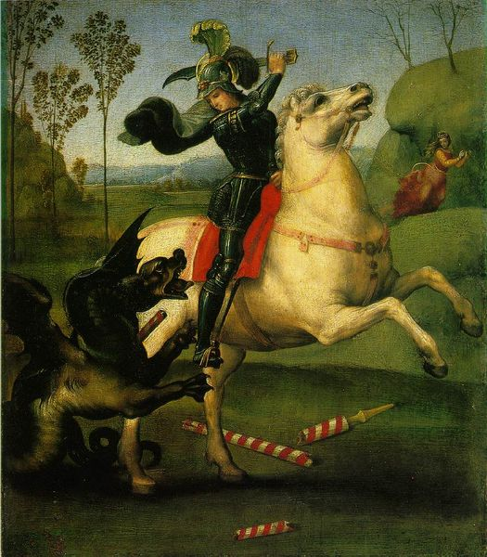
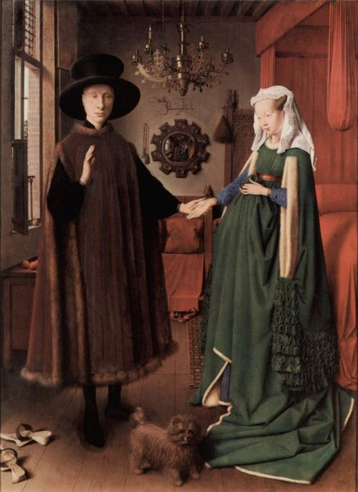
The Renaissance
Trade Expands
Trade brings goods and ideas to
an increasing number of people.
Trade also brings wealth.
City-States
Merchants in city-states become
wealthy and compete with one another
to make their city the most beautiful.
Nobles commission artists, architects.
Artists like
Raphael
(above,
St. George)
and
Jan van Eyck
(The Arnolfini
Portrait, right)
painted
people
realistically.
Renaissance Starts in Italy
Florence under Medici rule leads the way.
Humanism emerges: Belief in the individual,
return to classics, public service.
Renaissance Moves North
Ideas spread due to trade, travel,
and the printing press.
Achievements: Art, literature, science, architecture.

Slide 5
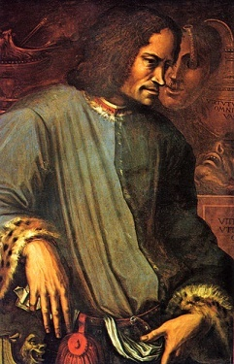
People of the Renaissance
Shopkeepers
Artisans
Merchants
Bankers
Farmers
Laborers

Slide 6
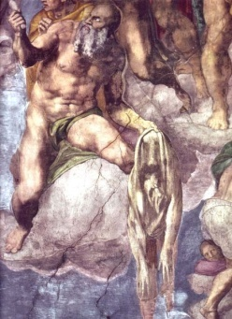
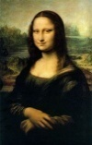
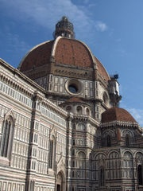
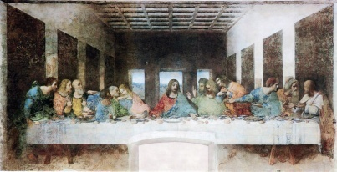
Renaissance
Humanism
Literature
Architecture
Painting
Petrarch
Dante
Alighieri
Return to elements of
Greek and Roman
architecture
Leonardo
da Vinci
Shakespeare
Cervantes
Michelangelo
Raphael
Recovered
classical texts,
translated them
into Italian
The
Divine
Comedy
Romeo
and
Juliet
Sistine
Chapel
Mona
Lisa,
Last
Supper
Don
Quixote
Columns, pillars,
arches, domes, niches
Linear
perspective
Mona Lisa,
by Leonardo da Vinci
The Last
Judgment, by
Michelangelo
The Last Supper,
by Leonardo da Vinci
Dante and The Divine
Comedy, by Michelangelo
The Duomo
designed by Brunelleschi

Slide 7
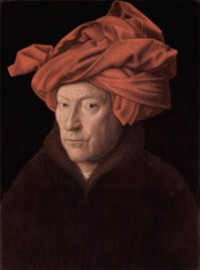
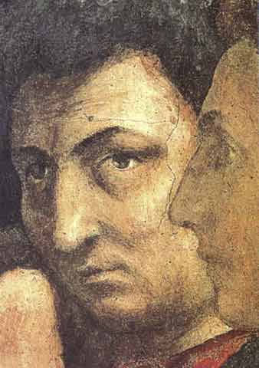
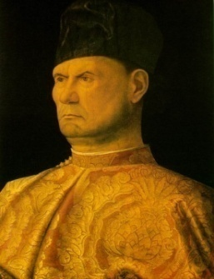
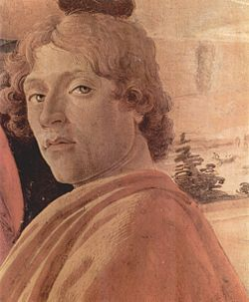
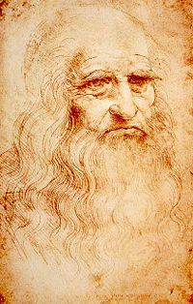
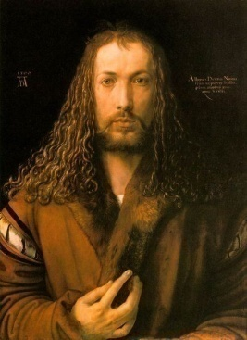
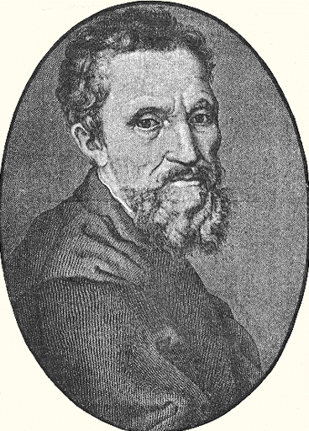
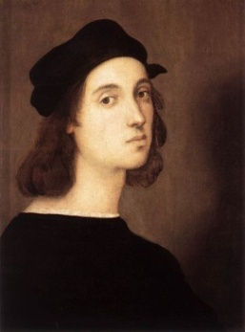
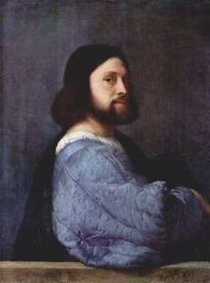
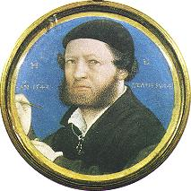
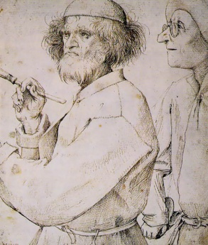
Jan van Eyck
1385-1441
Perfected oil
painting
techniques
Masaccio
1401-1428
Brancacci
Chapel
frescos
Giovanni
Bellini
1426-1516
Founder of
Venetian
school of
painting
Leonardo
da Vinci
1452-1519
Last Supper
Mona Lisa
Giotto
1267-1337
Brought in the
modern era
of painting
Sandro
Botticelli
1444-1510
Birth of Venus
Primavera
Raphael
1483-1520
Stanze di
Raffaello
(Raphael
Rooms),
Vatican
Hans Holbein
The Younger
1497-1543
Portraits at
court of
Henry VIII
Pieter
Bruegel
The Elder
1525-1569
Paintings of
peasant life
Albrecht
Dürer
1471-1528
Woodcuts
and
engravings
Michelangelo
Titian
1488-1576
Venice
school of
painting
Michelangelo
1475-1564
Sistine Chapel
David

Slide 8
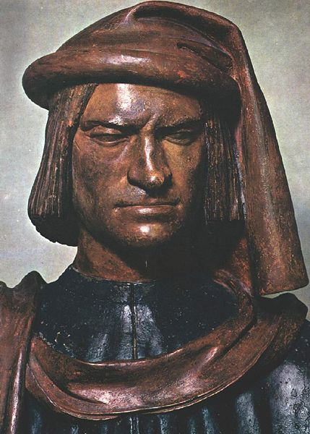
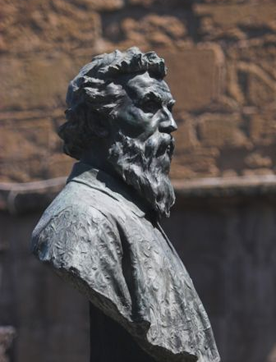
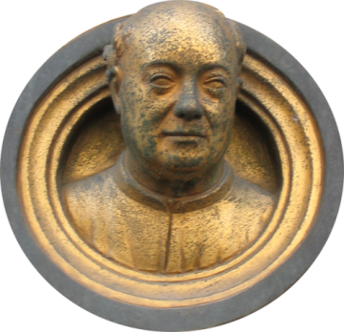
Lorenzo
Ghiberti
1378-1455
Doors of the
Florence
Baptistery
Benvenuto
Cellini
1500-1571
Perseus with
the Head of
Medusa
Andrea del
Verrocchio
1435-1488
Christ and
St. Thomas
Michelangelo
1475-1564
Sistine Chapel,
David
Donatello
1386-1466
David,
St. George

Slide 9
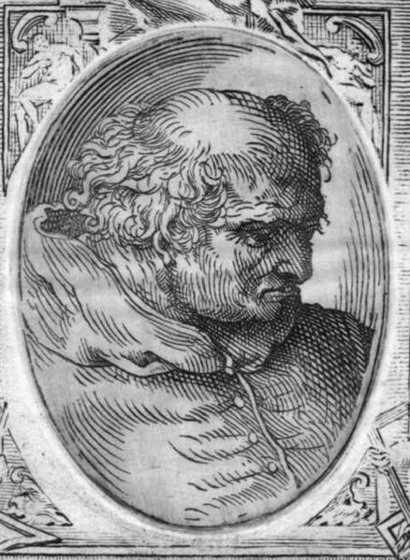
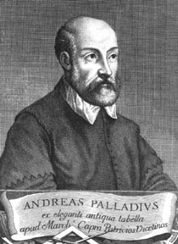
Filippo
Brunelleschi
1377-1446
Begins
construction on the
Duomo in
Florence.
Lorenzo
Ghiberti
1378-1455
Doors of the
Baptistery
In Florence.
Donato
Bramante
1444-1514
St. Peter’s
Basilica,
Rome.
Andrea Palladio
1508-1580
Andrea
Palladio
1508-1580
The Four Books of
Architecture,
1570.

Slide 10
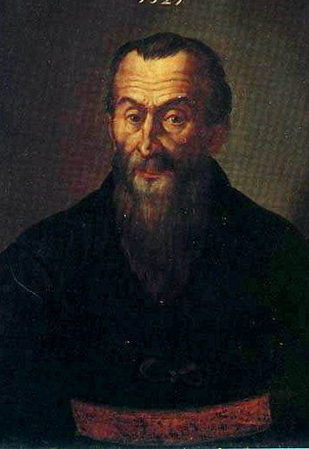
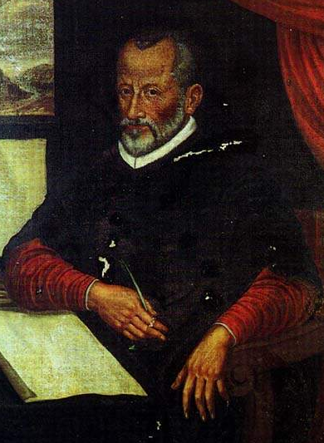
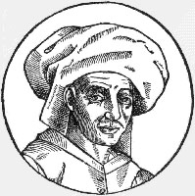
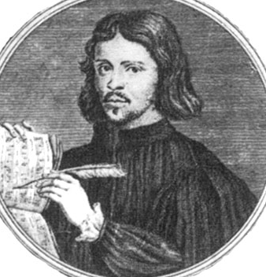
Josquin des
Prez
1440-1521
Master of
polyphonic
vocal music
Thomas
Tallis
1510-1585
Wrote for
Henry VIII
Giovanni Pierluigi
da Palestrina
1525-1594
Church music,
Missa Papae
Marcelli
Adrian Willaert
1490-1562
Founder
Venetian School
of music
Guillaume
Dufay
1397-1474
Polyphonic
church music

Slide 11
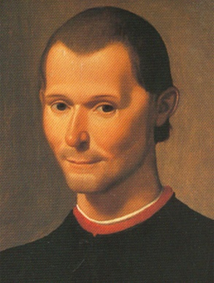
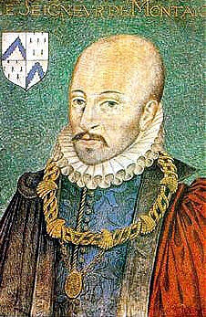
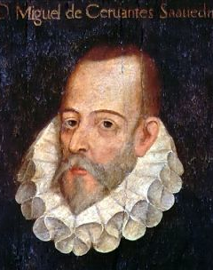
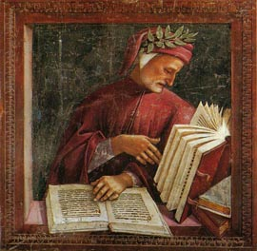
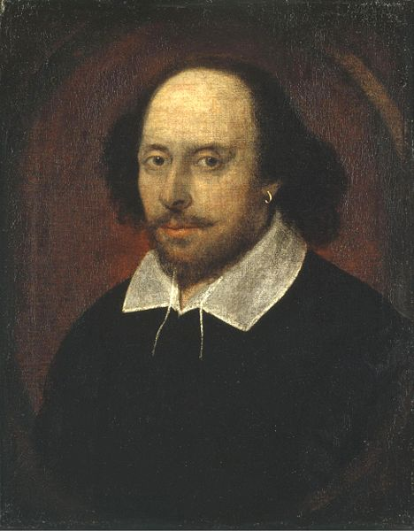
Writers of the Renaissance
Francesco
Petrarch
1304-1374
Sonnets
Giovanni
Boccaccio
1313-1375
Decameron
Niccolo
Machiavelli
1469-1527
The Prince
Michel de
Montaigne
1533-159
Popularized
the essay
Dante
Alighieri
1265-1321
The Divine
Comedy
Miguel de
Cervantes
1547-1616
Don Quixote
William Shakespeare
1564-1616
Romeo and Juliet

Slide 12
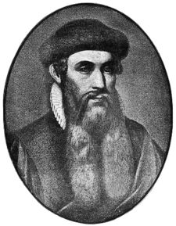
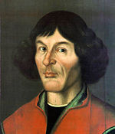
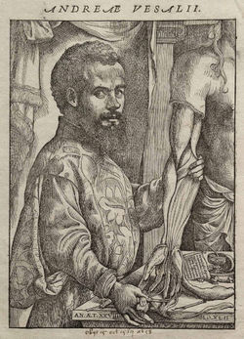
Johannes
Gutenberg
c. 1400-1468
Movable type,
printing press
Nicolaus
Copernicus
1473-1543
First scientist
to state
that the earth
was not the
center of the
universe
Leonardo da
Vinci
1452-1519
Anatomy,
inventions
Andreas
Versalius
1514-1564
Founder of
modern
human
anatomy
Galileo
Galilei
1564-1642
Astronomer,
philosopher,
mathematician,
physicist

Slide 13
Christopher
Columbus
1451-1506
Began
settlement
of the
New World
Ferdinand
Magellan
1480-1521
Circum-
navigated
the globe
Vasco da
Gama
1460 or
1469-1524
Sailed
around the
Cape of
Good Hope
Hernando
Cortes
1485-1547
Conquered
The Aztecs
Francisco
Pizarro
1471-1541
Conquered
the Inca
Gerardus
Mercator
1512-1594
Cartographer

